Slide 1
Structural optimization of truss using graphic statics and genetic algorithm
Presenters:
Bijay Ban 075/MSStE/001
Nabin Tandan 075/MSStE/006
Nishan Thapa 075/MSStE/008
Pramod Tiwari 075/MSStE/013
ADVISOR:
Asso. Prof. Dr. Bharat Mandal, PhD

Slide 2
NEED OF STUDY - motivation
To get a optimum structure for given boundary constraints in a truss, each, among, topology, shape and size optimization should be done.
Creation of a computational system that suggests optimum shape during earlier design stage would help to minimize efforts for cost reductions in later stage.
.With availability of high computational power, different algorithms for optimized structures are to be explored and refined.

Slide 3
Objective of the study
General objective:
To explore topology, shape and size optimization of trusses.
Specific objectives:
To suggest the optimized topology and shape for various spans of trusses.
To introduce and explore Graphic Statics as a method of truss optimization and create a system in Rhino Grasshopper environment that creates optimum structure with ease.

Slide 4
METHODOLOGY

Slide 5
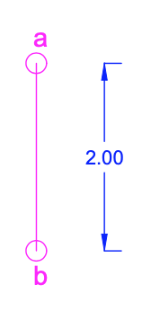
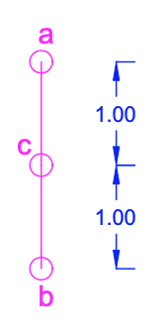
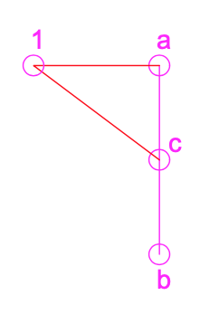
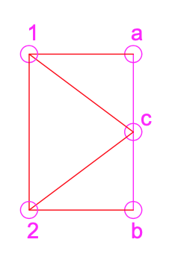
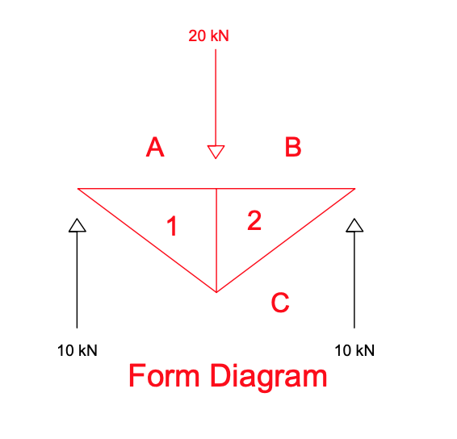
Graphic Statics - steps
GIVEN FORM DIAGRAM
step1
step2
Step 3
Step 4

Slide 6
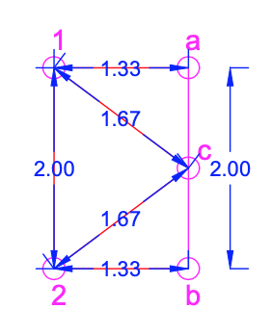
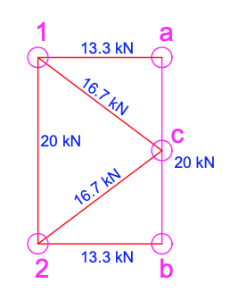
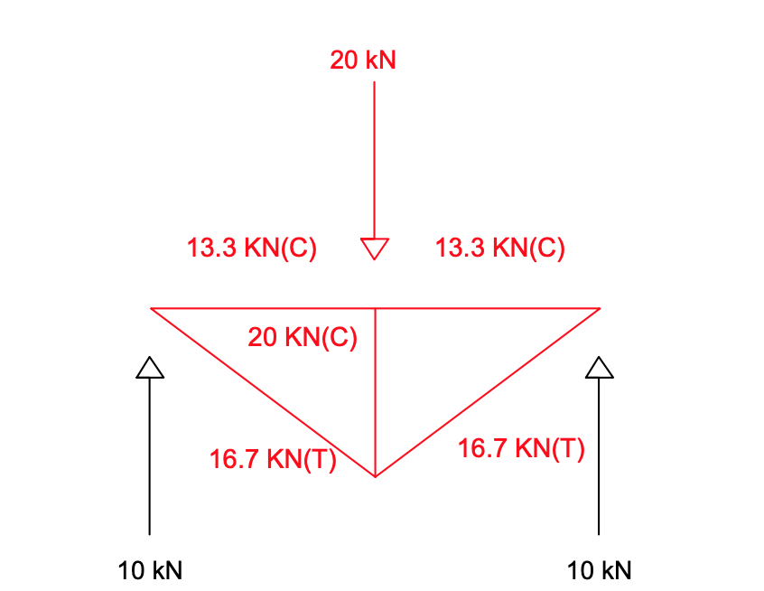
FORCE DIAGRAM ON DEFAULT UNIT
FORCE DIAGRAM LENGTH – SCALED TO FORCE UNIT
OBTAINED MEMBER FORCES

Slide 7
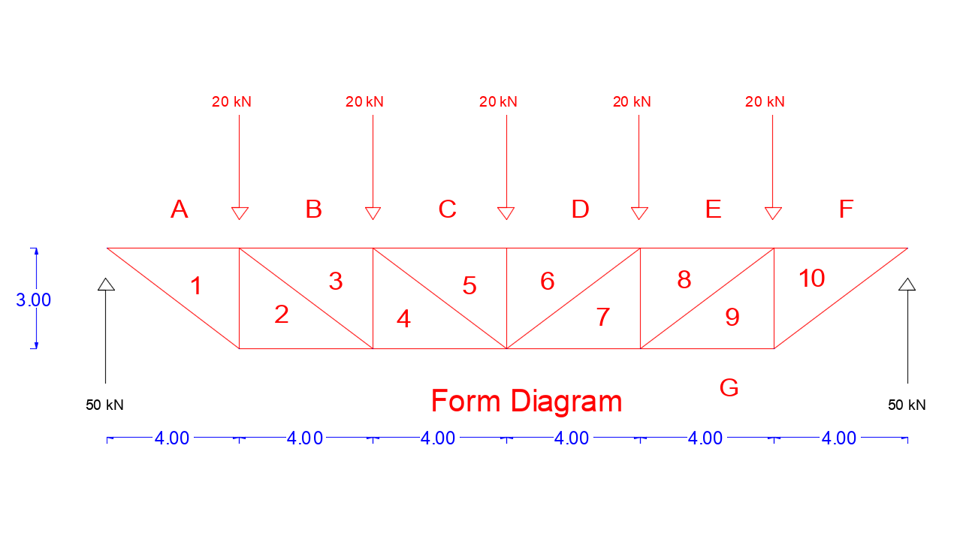
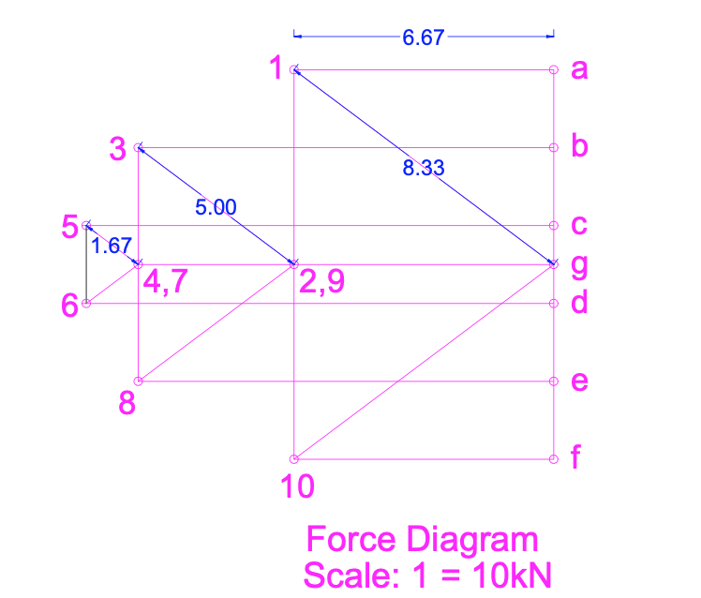
Validation of Graphic Statics from Etabs Software

Slide 8
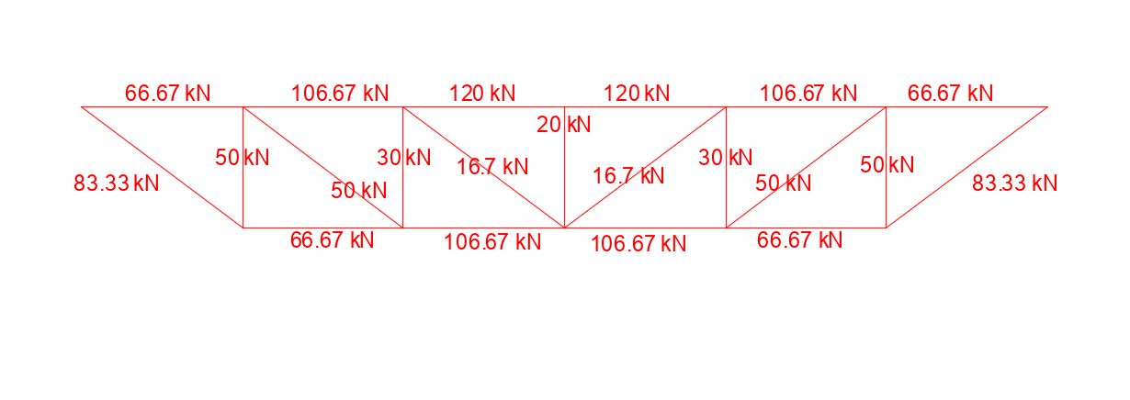
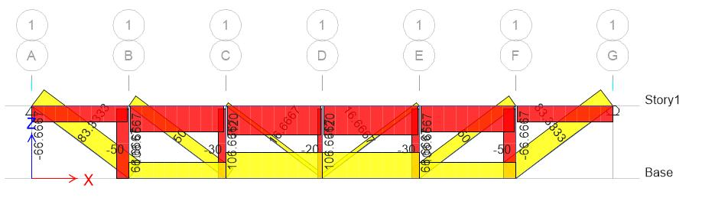
COMPARISION OF FORCES OBTAINED FROM GRAPHIC STATICS AND ETABS
MEMBER FORCES FROM GRAPHIC STATICS
MEMBER FORCES FROM ETABS ANALYSIS

Slide 9
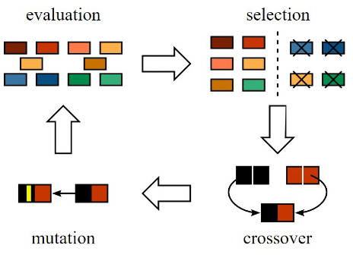
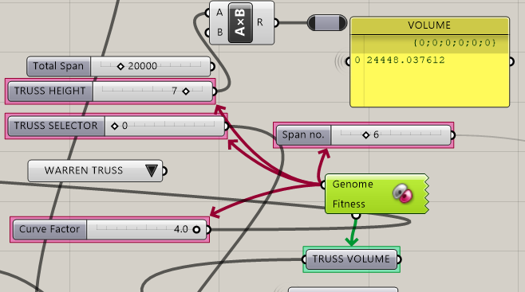
F GALAPAGOS – EVOLUTIONARY SOLVER – GENETIC ALGORITHM
Fig. General overview of Evolutionary solver mechanism
Fig. Galapagos Genome and Fitness connection

Slide 10
FITNESS FUNCTION FOR MINIMIZATION
Minimize : function of volume (Fitness)
Minimize
where,
L_TD = Length of line in FORM Diagram
L_FD = Length of line in FORCE diagram
C_BIAS = 0.8 for Compressive Force
= 1 for Tensile Force
J_BIAS = 0.04 Joint bias 4% of load on member

Slide 11
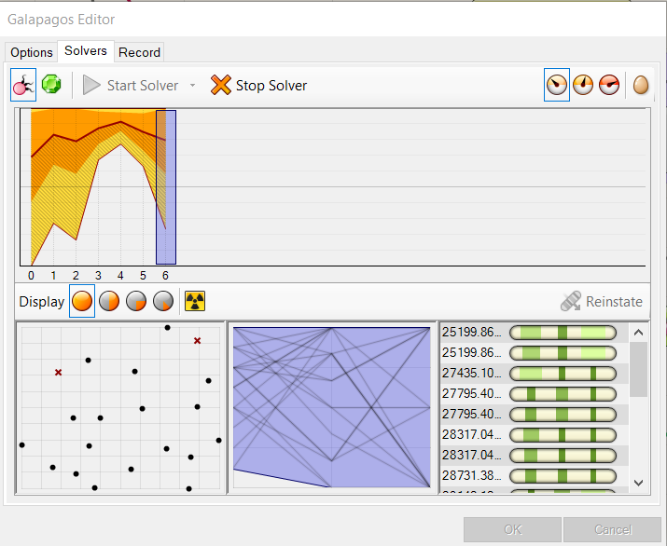
GALAPAGOS –EDITOR
Generic :
Fitness : Minimize
Runtime Limit : 30 minutes
Evolutionary Solver:
Population Size : 20 per generation
Initial Boost : 2
Maintain Population : 10%
Inbreeding : 75%

Slide 12
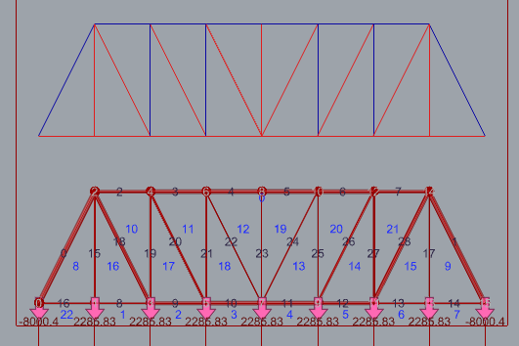
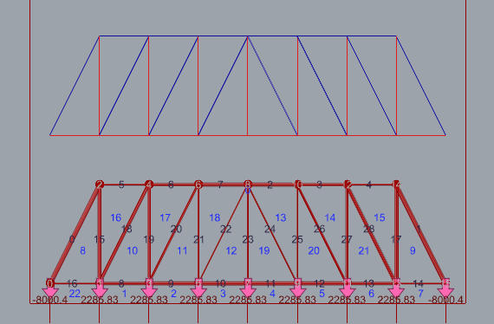
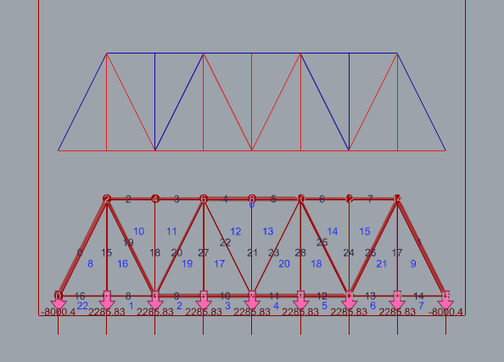
TYPES OF TRUSSES CONSIDERED
FIG. 1 PRATT TRUSS
FIG. 2 HOWE TRUSS
FIG. 3 WARREN TRUSS

Slide 13
Analysis & result

Slide 14
Analysis & result

Slide 15
Analysis & result

Slide 16
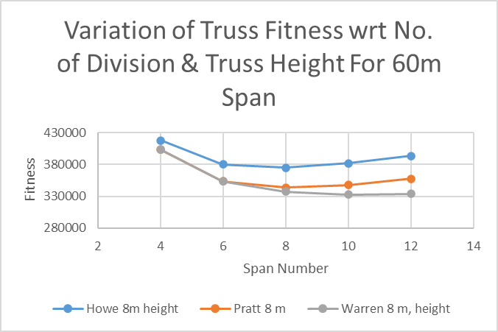
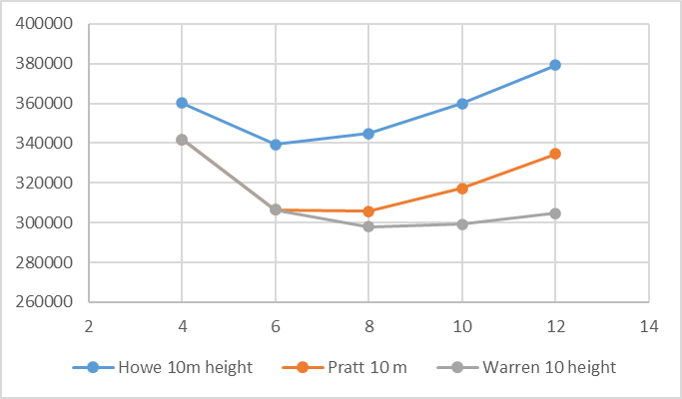
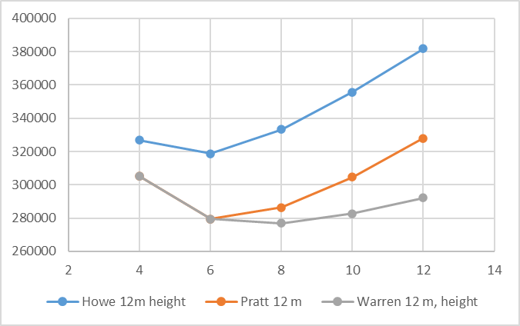
Analysis result

Slide 17
ANALYSIS RESULTS

Slide 18
Conclusion
Weight of a truss for given no. of spans decrease as we increase the height until a certain point from which it decreases, same is case for fixed height where weight of truss decrease as we increase no. of divisions until a point after which it increases again.
Compared to straight profile upper chord, parabolic shape of the top chord in trusses reduces the overall weight for same topology in case of UDL .
Combination of Graphic Statics for structural analysis and Genetic Algorithm for optimization can be used with computational ease, to determine the optimum shape of common bridge and roof trusses. The project presents a system that allows users to generate truss shapes and topologies that are efficient for dominant load cases of UDL.

Slide 19
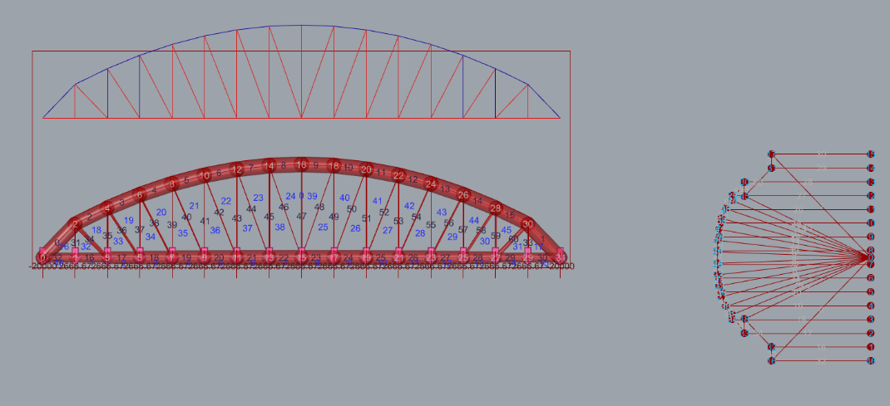
FORM FORCE DIAGRAM OF 80M truss with udl

Slide 20
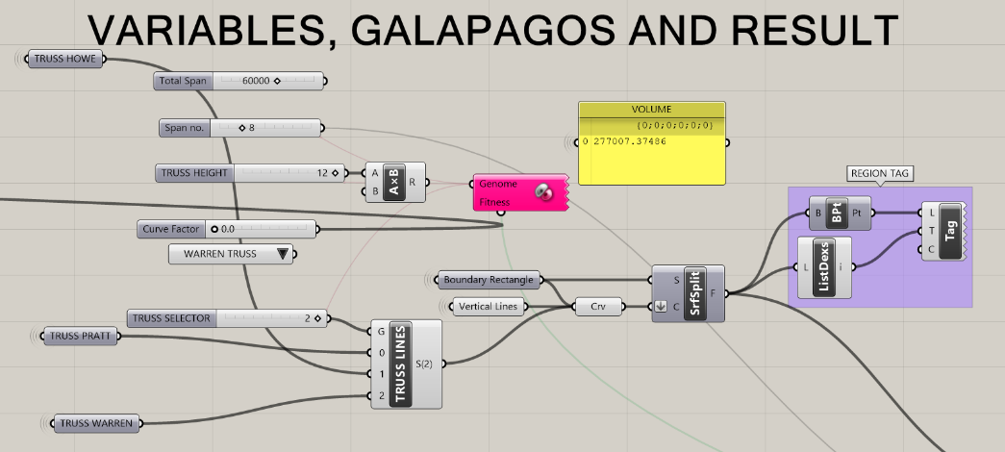

Slide 21
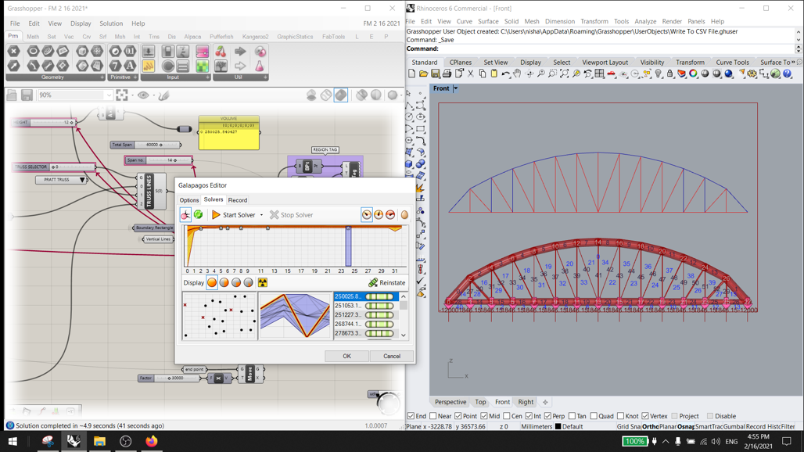

Slide 22
Limitations of study
Consideration of dominant load case - UDL at bottom chord only; multiple load combinations not included.
Joint costs and buckling idealized through bias factor.
Exact estimation of costs including erection, labor charges, etc. has not been considered.
Extension of 2d analysis to 3d.

Slide 23
End of presentation
THANK YOU

